Slide 1
User Interface Structure Design
Chapter 11
Slide <number>
PowerPoint Presentation for Dennis, Wixom & Tegarden Systems Analysis and Design
Copyright 2001 © John Wiley & Sons, Inc. All rights reserved.

Slide 2


Interface Structure Design
Window navigation diagram (WND)
  Shows how all screens, forms, and reports are related
  Shows how user moves from one to another
  Like a state diagram for the user interface
    Boxes represent components
    Arrows represent transitions
    Stereotypes show interface type
Slide <number>
PowerPoint Presentation for Dennis, Wixom & Tegarden Systems Analysis and Design
Copyright 2001 © John Wiley & Sons, Inc. All rights reserved.

Slide 3
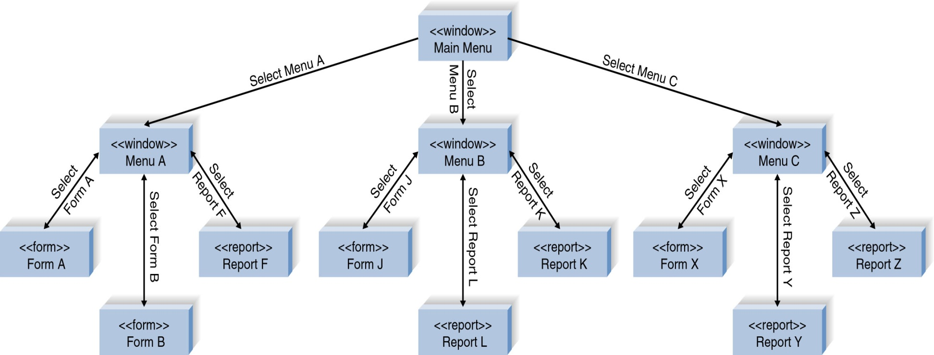
Window Navigation Diagram Example
Slide <number>
PowerPoint Presentation for Dennis, Wixom & Tegarden Systems Analysis and Design
Copyright 2001 © John Wiley & Sons, Inc. All rights reserved.

